Slide 1
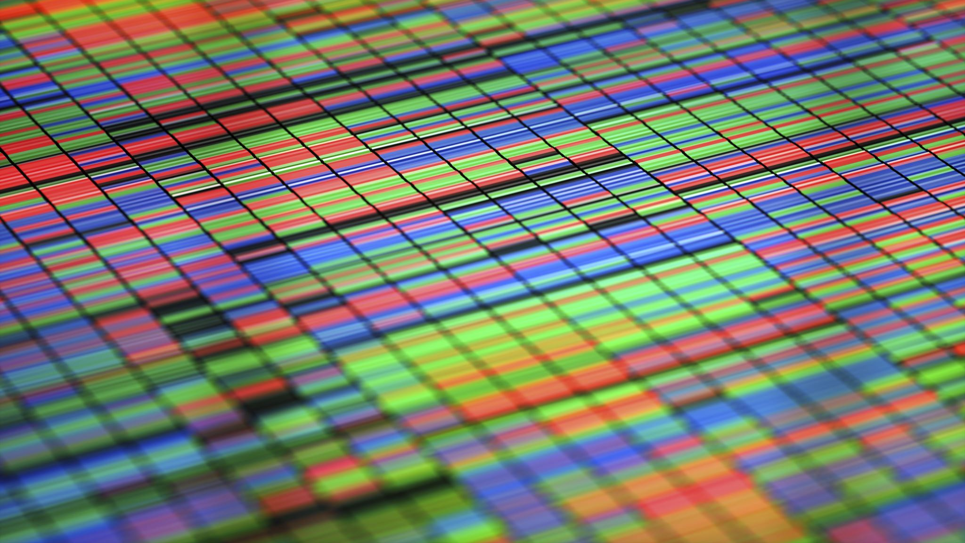
DATA Exploration DATA Visualization
Discovery and Learning with Big Data/Data Discovery

Slide 2


Best/Worst Practices for Visualizing Data

Slide 3

Visualization: Bad Examples
Please take a moment and try to list a few reasons why the following visualizations are bad/good!
Notes:
Source for the images: https://www.businessinsider.com/the-27-worst-charts-of-all-time-2013-6

Slide 4
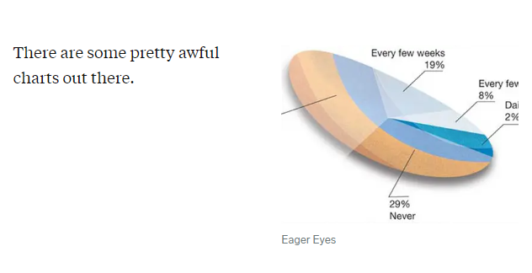

Slide 5
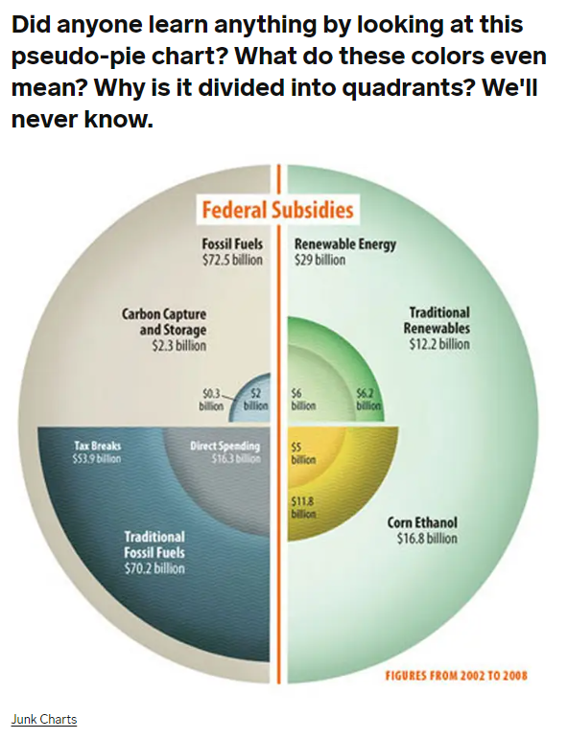

Slide 6
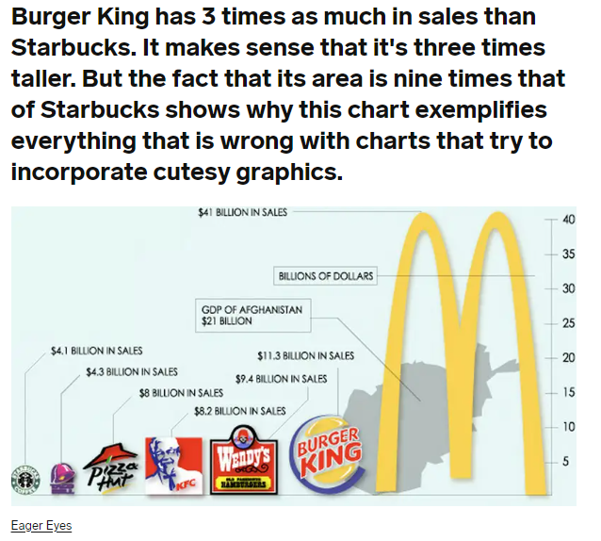

Slide 7
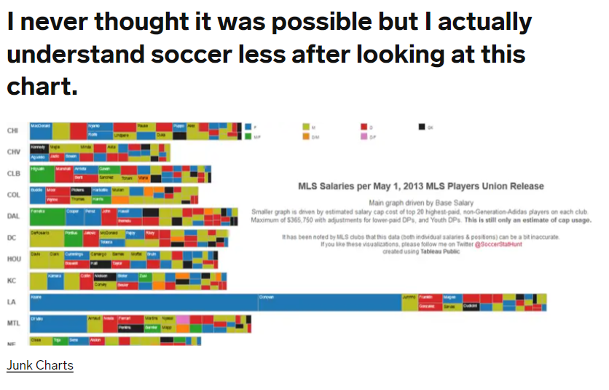

Slide 8
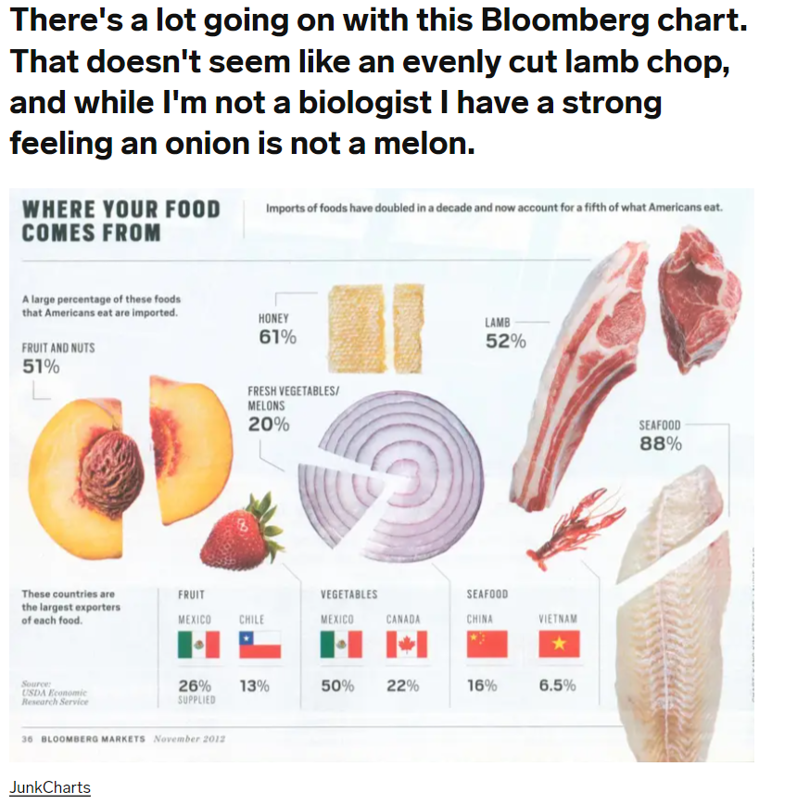

Slide 9
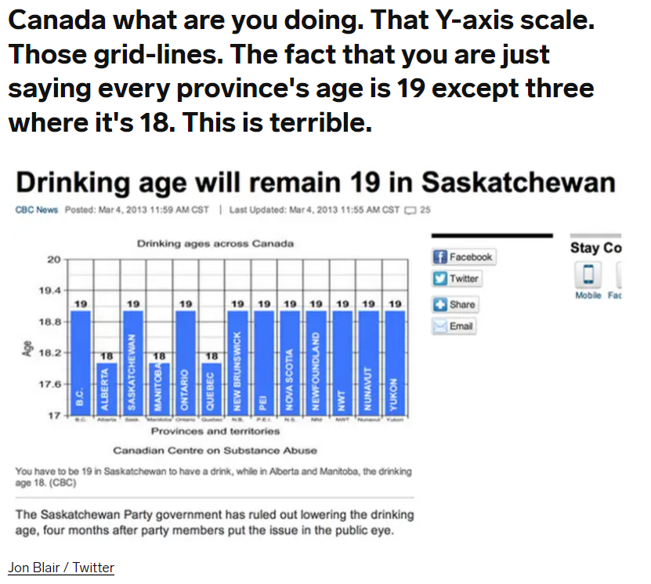

Slide 10
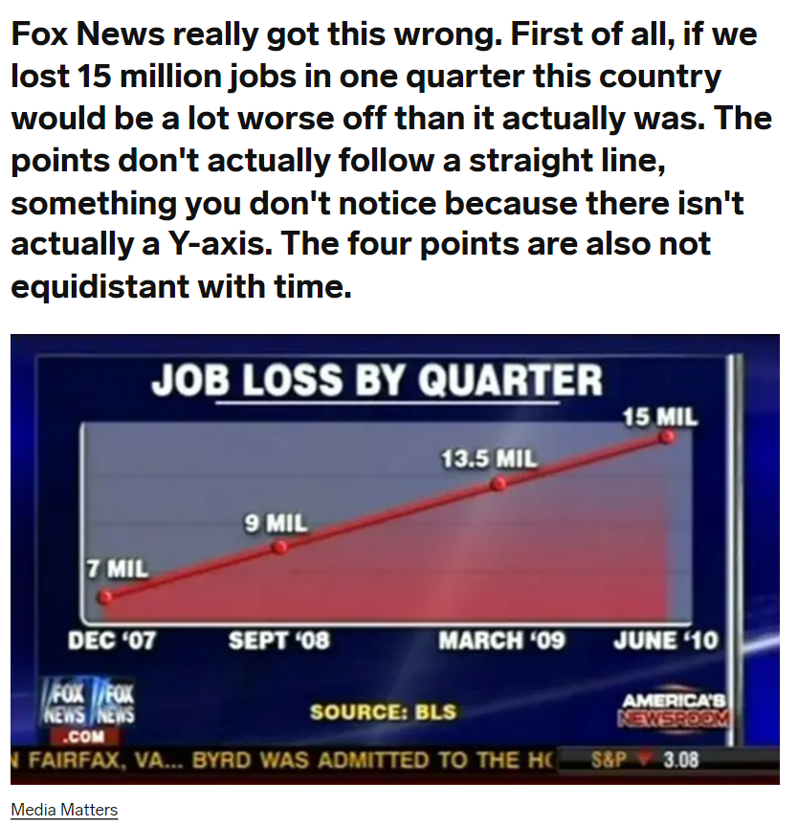

Slide 11
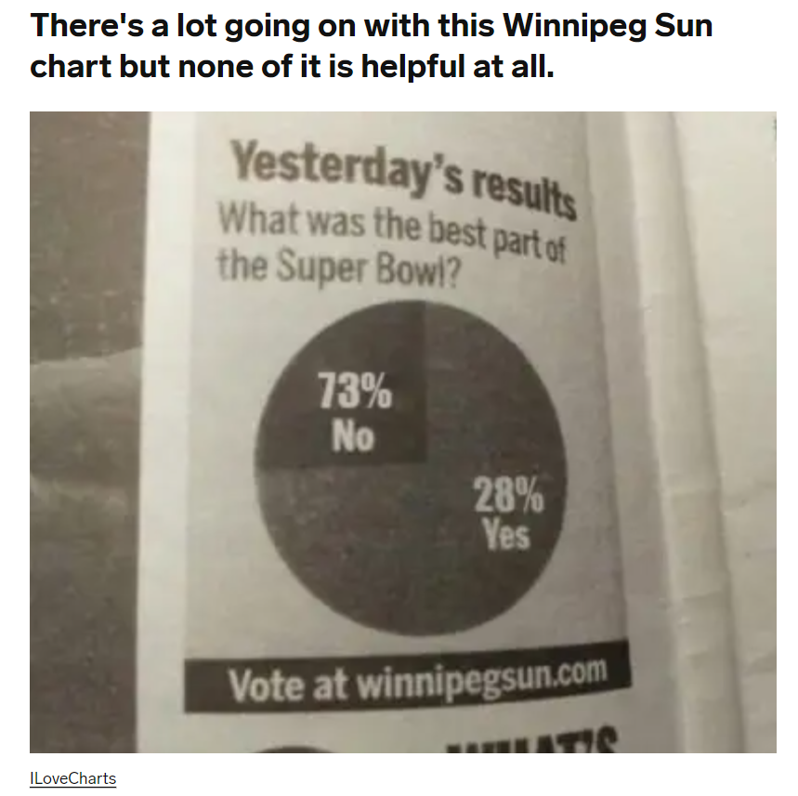

Slide 12

Visualizing Data with One Feature

Slide 13

Categorical vs. Numerical Features
A categorical feature consists of observations that represent labels or names.
A numerical feature contains numbers that vary over many values.
Examples???

Slide 14

Categorical Feature
A categorical feature divides the dataset into different groups or categories.
A bar chart(frequency bar chart) has the groups on one axis and then rectangles with heights that represent the number of individuals in that group.
Summarize the data with a frequency distribution.
Group the data into categories and record the number of observations that fall into each category.
The relative frequency for each category is the proportion of observations in each category.
Multiply the proportions by 100 to get percentages.
A relative frequency bar chart is a bar chart, but the height of each bar corresponds to the proportion of the dataset in each group.

Slide 15
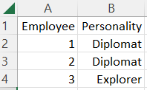
Visualize a Categorical Feature
Example: Myers-Briggs assessment personality types for 1,000 employees at a technology firm.
Which one do you prefer? Why?

Slide 16

Visualize a Categorical Feature
A bar chart depicts the frequency or relative frequency for each category of the categorial Feature.
Series of either horizontal or vertical bars
Bar lengths proportional to the values they are depicting
A pie chart is a segmented circle whose segments portray the relative frequencies of the categories of a qualitative variable.

Slide 17
Visualize a Categorical Feature
Which one do you prefer? Why?

Slide 18
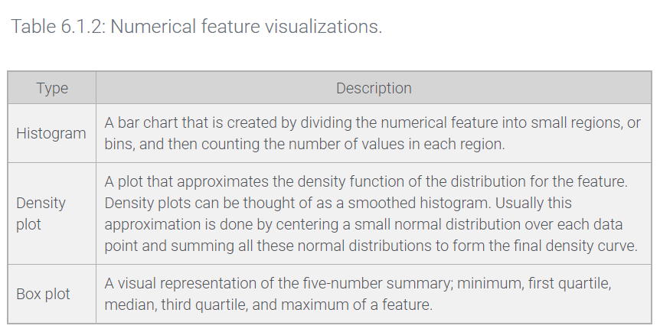
Visualize a Numerical Feature
Numerical features have a range of values that vary.
Communicate this aspect when visualizing numerical features.
Approaches:
Histogram
Density plot
Box plot
Notes:
https://learn.zybooks.com/zybook/UNTADTA5340OrhanFall2023/chapter/6/

Slide 19
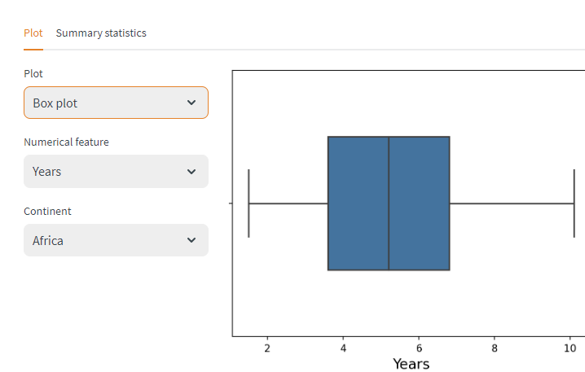
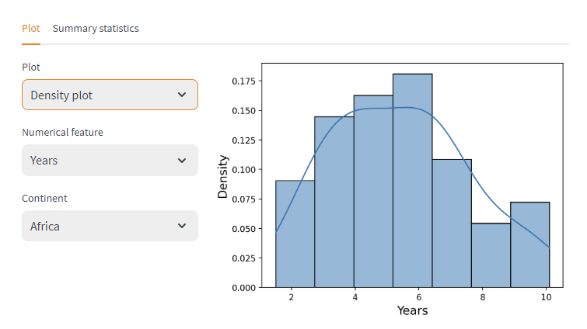
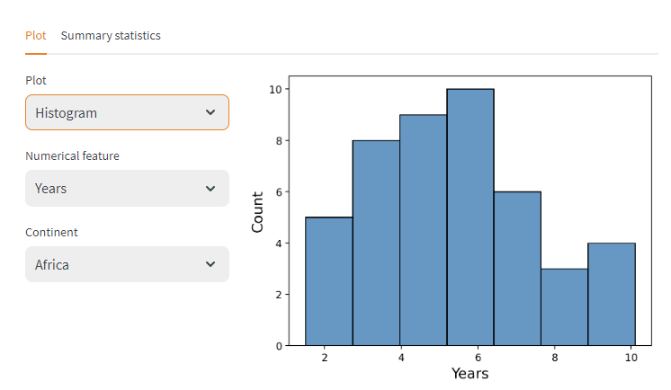
Notes:
https://learn.zybooks.com/zybook/UNTADTA5340OrhanFall2023/chapter/6/

Slide 20

Visualize a Numerical Feature
For a categorical, the raw data could be categorized in a well-defined way.
With a numerical feature, each observation represents a meaningful amount or count.
Use a frequency distribution to summarize a numerical feature.
Instead of categories, we construct a series of intervals or classes.
The data are more manageable using a frequency distribution, but some detail is lost.

Slide 21
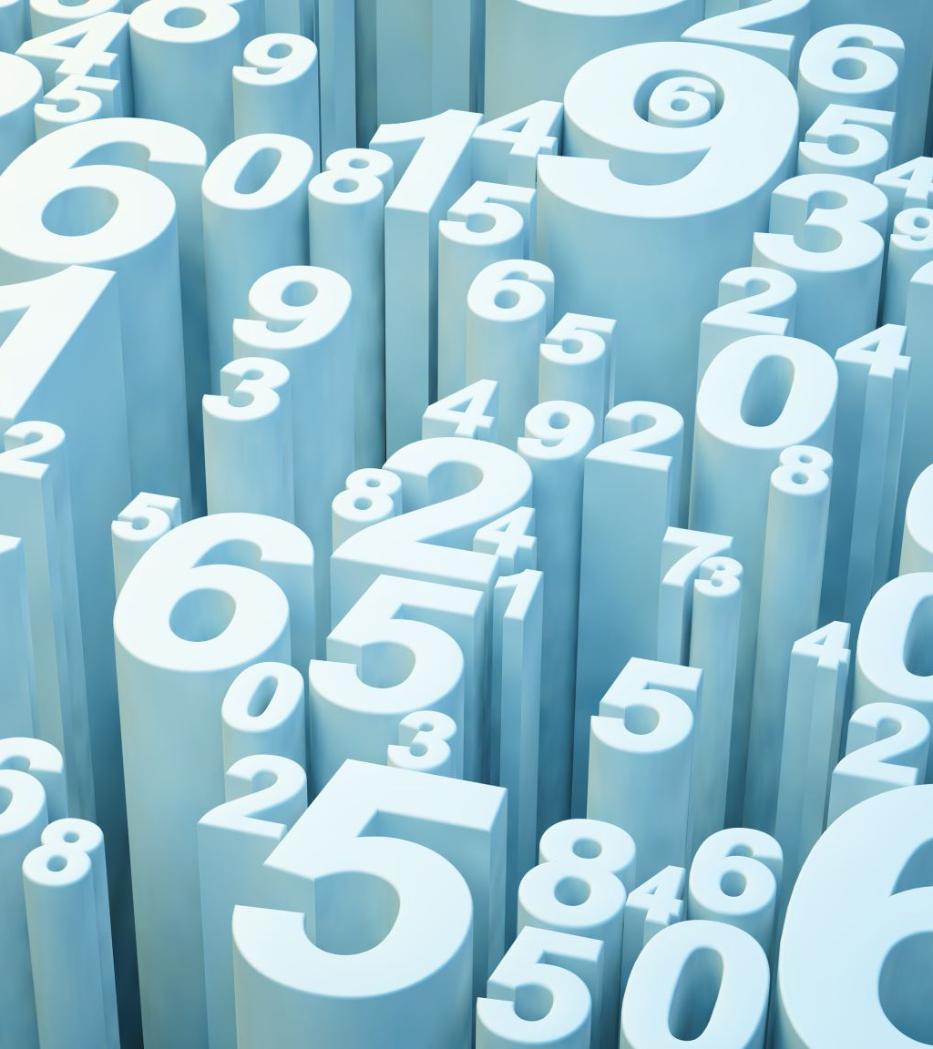
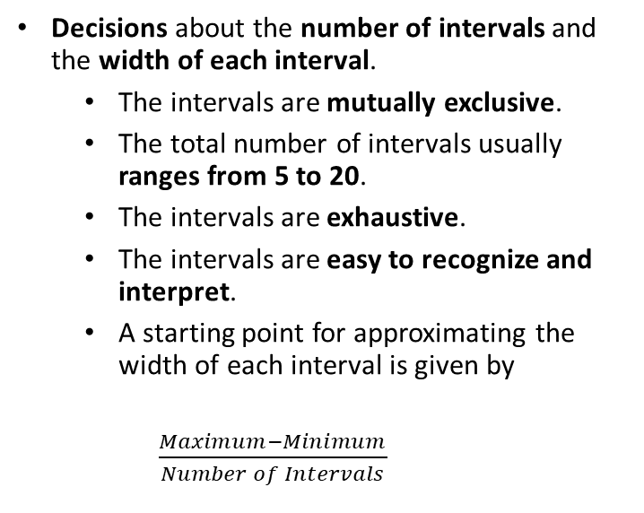
Visualize a Numerical Feature
Decisions about the number of intervals and the width of each interval.
The intervals are mutually exclusive.
The total number of intervals usually ranges from 5 to 20.
The intervals are exhaustive.
The intervals are easy to recognize and interpret.
A starting point for approximating the width of each interval is given by
$\frac{Maximum−Minimum}{Number of Intervals}$

Slide 22
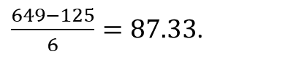
Visualize a Numerical Feature
Example: house prices in Punta Gorda
Suppose we are going to have 6 intervals.
The maximum is 649 and the minimum is 125.
As a starting point, the width of each interval could be:
This would not give limits that are easily recognizable, so we use 100.
$\frac{649−125}{6}=87.33$.

Slide 23

Visualize a Numerical Feature
In addition to a frequency distribution, there are three other items to compute.
Relative frequency: proportion (or fraction) of observations that falls into each interval.
Cumulative frequency: the number of observations that falls below the upper limit of a particular interval.
Cumulative relative frequency: the proportion (or fraction) of observations that falls below the upper limit of a particular interval.

Slide 24
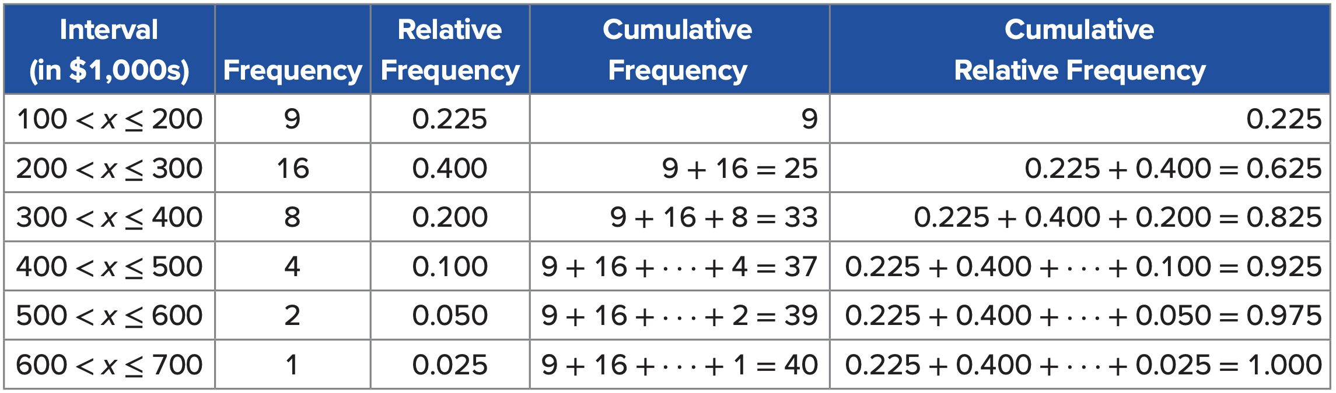
Visualize a Numerical Feature
Example: house prices in Punta Gorda (Total count is 40)
Use the previous frequency distribution to determine the below.
Frequency/40

Slide 25

Visualize a Numerical Feature
A histogram is the counterpart to the vertical bar chart used for a categorical feature.
Graphically depict a frequency distribution for a numerical feature.
A series of rectangles
Mark off along the horizontal axis
The height of each bar represents the frequency or relative frequency for each interval
No gaps between bars/intervals

Slide 26
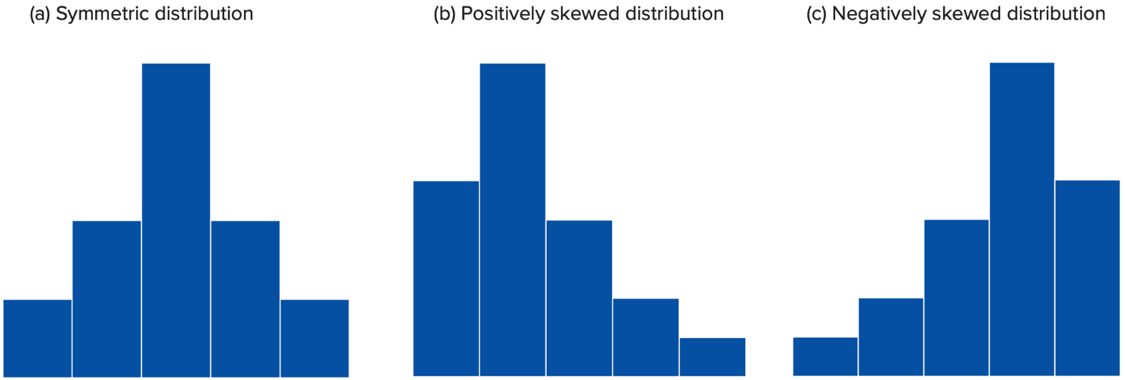
Visualize a Numerical Feature
A histogram allows us to quickly see where most of the observations tend to cluster.
A histogram indicates the spread and shape of the feature.
Symmetric: mirror image of itself on both sides of its center
Skewed: positive (elongated right tail) or negative (elongated left tail)

Slide 27
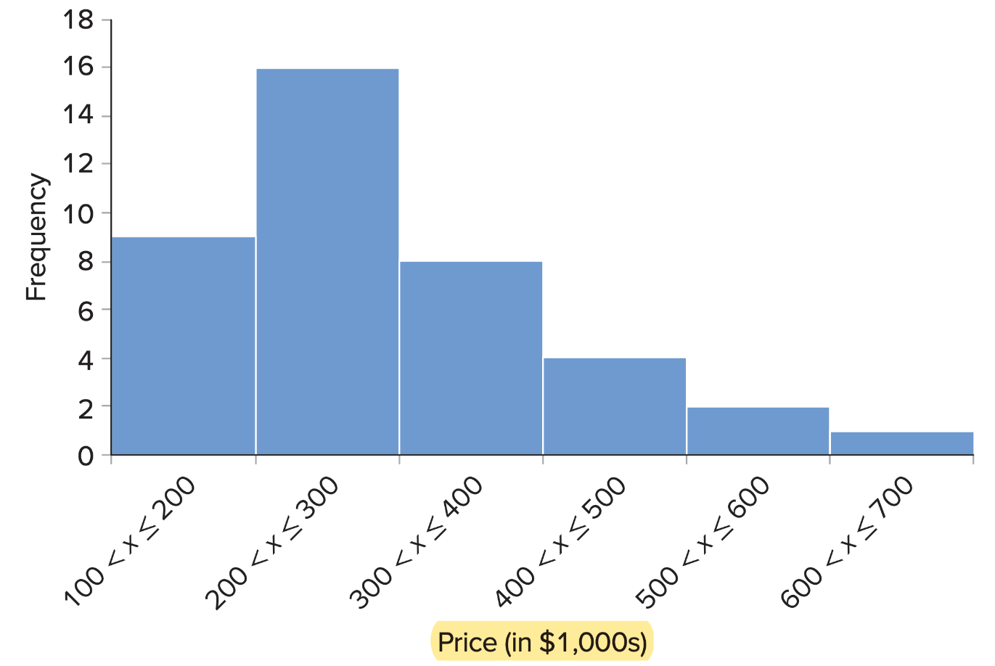
Visualize a Numerical Feature
Good or bad?

Slide 28

Visualizing Data with Multiple Features

Slide 29
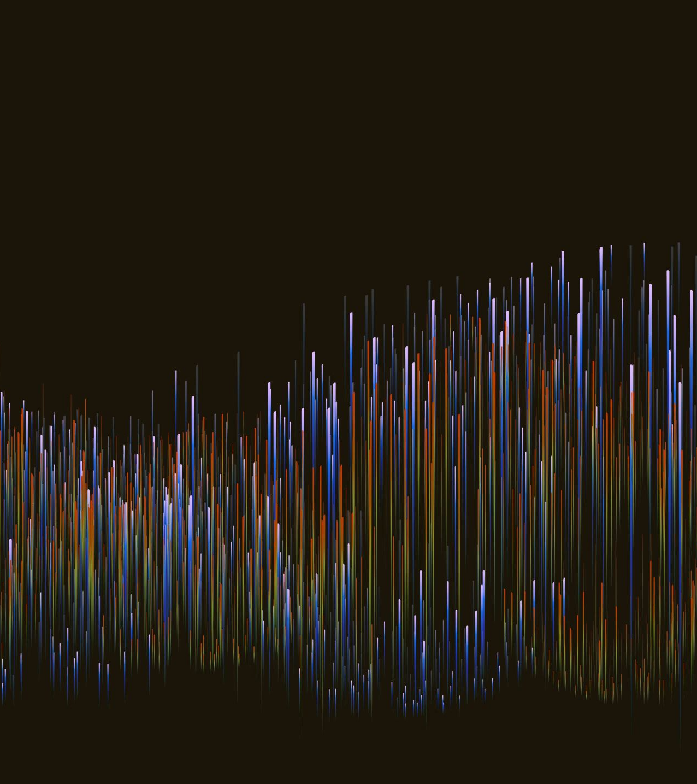
Visualizing Data with Multiple Features
Visualizing more than one feature ➔ the relationship between them.
Two numerical features ➔ a scatter plot
With more than two features, the screen cannot display enough directions for the information.
Numerical features ➔ color, size, transparency, and animation
Categorical features ➔ color, shading, size, transparency, shape, and faceting
Faceting is the practice of displaying multiple plots side by side in an array where one feature changes from plot to plot.
Notes:
https://learn.zybooks.com/zybook/UNTADTA5340OrhanFall2023/chapter/6/

Slide 30
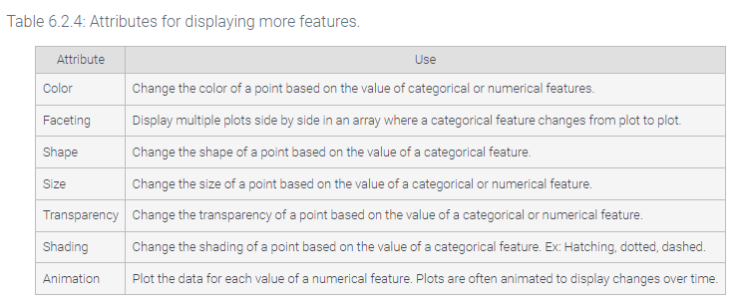
Notes:
https://learn.zybooks.com/zybook/UNTADTA5340OrhanFall2023/chapter/6/

Slide 31

Visualize the Relationship Between Two Categorical Features
Use a contingency table to examine the relationship between two categorical features.
Frequencies for two categorical features
Each cell represents a mutually exclusive combination of the pair of values

Slide 32
Visualize the Relationship Between Two Categorical Features
Use a stacked column chart/stacked bar chart to visualize more than one categorical feature.
A bar chart is created with one categorical feature.
The second feature divides, with color or shading, each bar.
The height of each piece is based on the number of instances with values matching the bar and shading.
Graphically shows the contingency table
Allows for the comparison compositive within each category
Use a grouped bar chart to visualize more than one categorical feature.
A bar is created for each possible pair of values.
The height of the bar is based on the number of instances with that pair of values.
Bars are grouped by one feature and colored by the other feature.

Slide 33
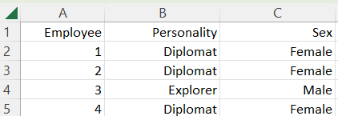
Visualize the Relationship Between Two Categorical Features
 | Personality
Sex | Analyst | Diplomat | Explorer | Sentinel
Female | 55 | 164 | 194 | 79
Male | 61 | 160 | 210 | 77

Slide 34
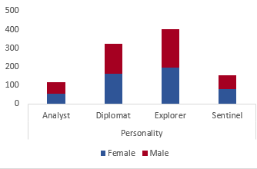
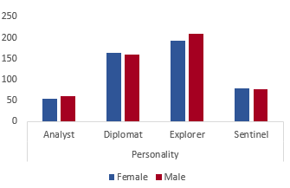
Visualize the Relationship Between Two Categorical Features
 | Personality
Sex | Analyst | Diplomat | Explorer | Sentinel
Female | 55 | 164 | 194 | 79
Male | 61 | 160 | 210 | 77

Slide 35
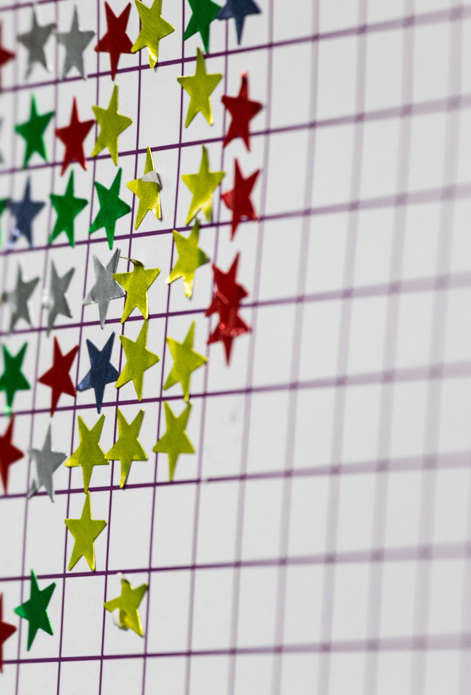
Visualization with multiple variables
Use a scatterplot to examine the relationship between two numerical features.
Determine if two numerical features are related in some systematic way
Each point represents a pair of observations of the two Features
Refer to one Feature as x (x-axis) and the other as y (y-axis)

Slide 36
Visualization with multiple variables
Once plotted, the graph may reveal one of the below.
A linear relationship
A nonlinear relationship
No relationship

Slide 37
Visualization with multiple variables

Slide 38

Visualization with multiple variables
A scatterplot with a categorical feature modifies a basic scatterplot.
Incorporate a categorical feature in addition to the two numerical features
Encode the categorical feature with color
Giving each point a distinct hue makes it easy to show its category
This allows you to determine if the relationship between x and y differs across the values of the categorical feature.

Slide 39
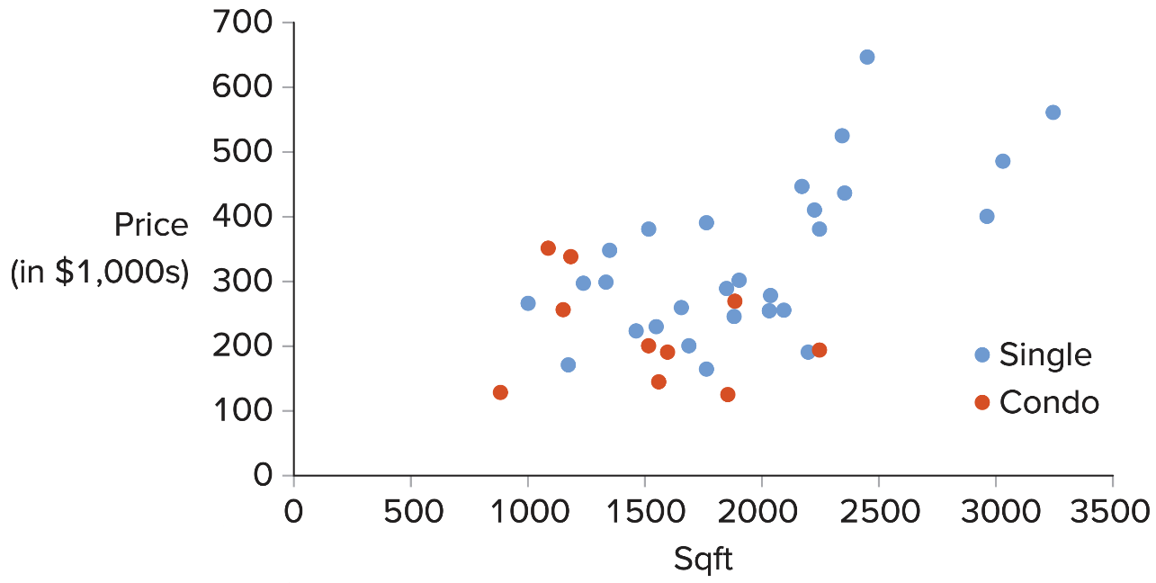
Visualization with multiple variables

Slide 40
Visualization with multiple variables
A line chart displays a numerical feature as a series of consecutive observations connected by a line.
A line chart is especially useful for tracking changes or trends over time.
It is also easy for us to identify any major changes that happened in the past on a line chart.
When multiple lines are plotted in the same chart, we can compare these observations on one or multiple dimensions.

Slide 41
Visualization with multiple variables

Slide 42
To do, or not to do, that is the question
The simplest graph should be used.
Axes should be clearly marked with numbers and scales.
Bars on bar charts should have the same width.
Vertical axis should not have very high values as an upper limit.
Vertical axis should not be stretched.

Slide 43

Tools for Visualizing Data

Slide 44
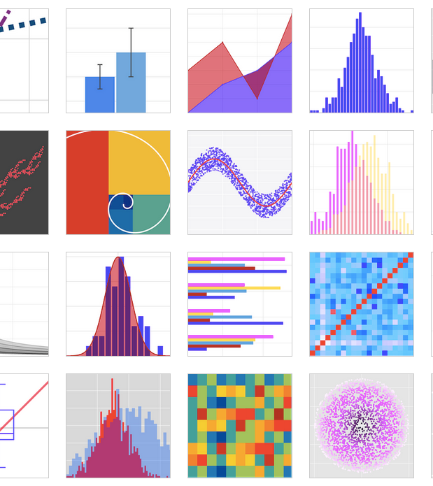
Tools
Spreadsheets: Microsoft Excel, Google Sheets, LibreOffice Calc
Business intelligence applications (BIAs): create reports and visualizations from various data sources using a visual interface. PowerBI, Tableau, Looker.
R ggplot2
library(ggplot2)
GasUsage = read.csv("GasUsage.csv")
ggplot(GasUsage, aes(x = Temp, y = Gas, size = Solar)) + geom_point()
R and Python Plotly: Plotly is a company that provides data visualization services and open-source data visualization libraries for Julia, Python and R. Plotly creates visualizations using a javascript library, plotly.js, which allows for interaction.
import pandas as pd
import plotly.express as px
GasUsage = pd.read_csv("GasUsage.csv")
px.scatter(GasUsage, x=‘Temp', y=‘Gas', size=‘Solar')
This Photo by Unknown Author is licensed under CC BY-SA
Notes:
https://learn.zybooks.com/zybook/UNTADTA5340OrhanFall2023/chapter/6/

Slide 45
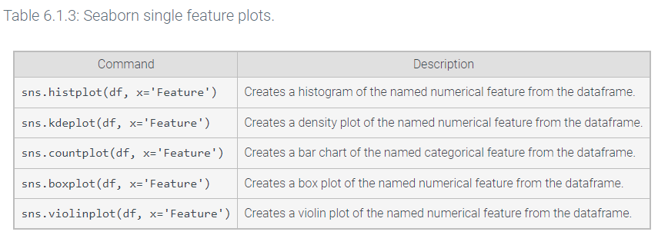
Seaborn
Seaborn is a Python package for visualization that is built on top of matplotlib and simplifies the syntax of it.
Each type of plot is called with a named function.
The dataframe and features to plot are passed as parameters.
Notes:
https://learn.zybooks.com/zybook/UNTADTA5340OrhanFall2023/chapter/6/
The Seaborn library was apparently named after a character named Samuel Norman Seaborn from the television show "The West Wing" - thus, the standard alias is the character's initials ("sns").

Slide 46

Exploratory Data Analysis(EDA)

Slide 47
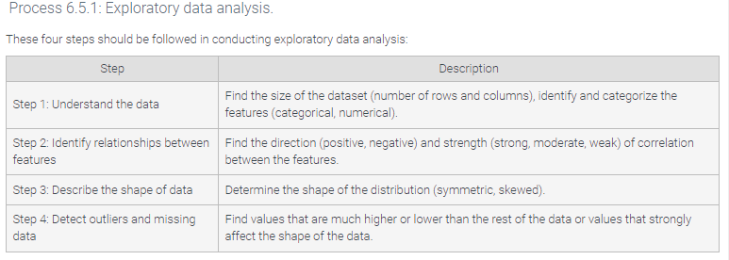
Steps of EDA

Slide 48
Steps in EDA
Types of data: Size, rows, columns, values, types, features
Relationships: Correlations
Linear, complex, none
Positive, negative, none
Strong, moderate, weak
Shape: Symmetric, skewed, unimodal, multimodal
Outliers or missing values

Slide 49
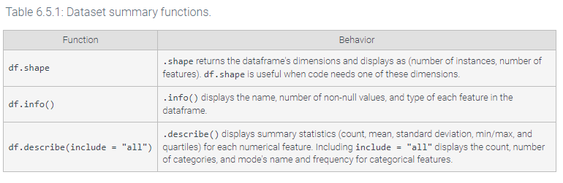

Slide 50
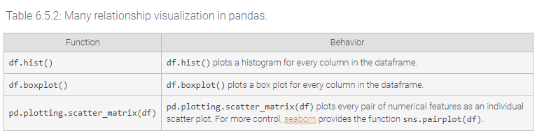

Slide 51


Examples
This Photo by Unknown Author is licensed under CC BY-SA

Slide 52
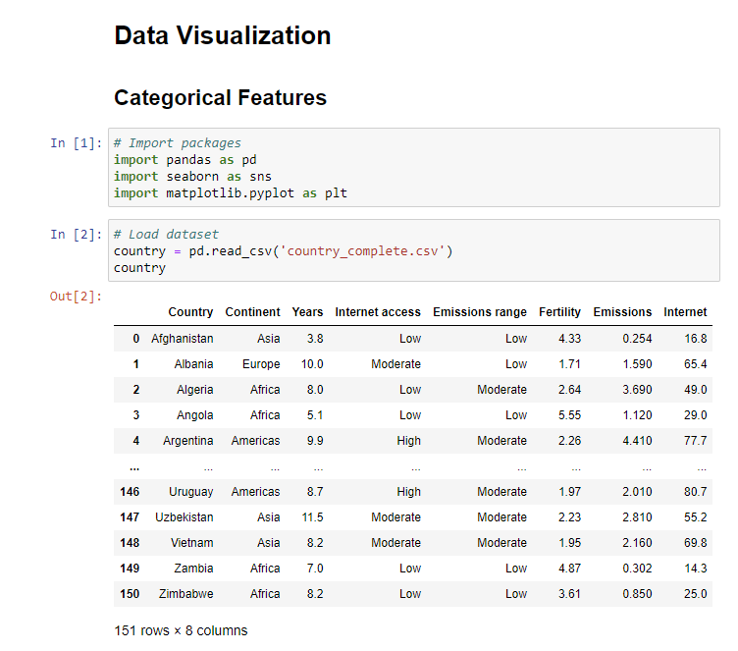
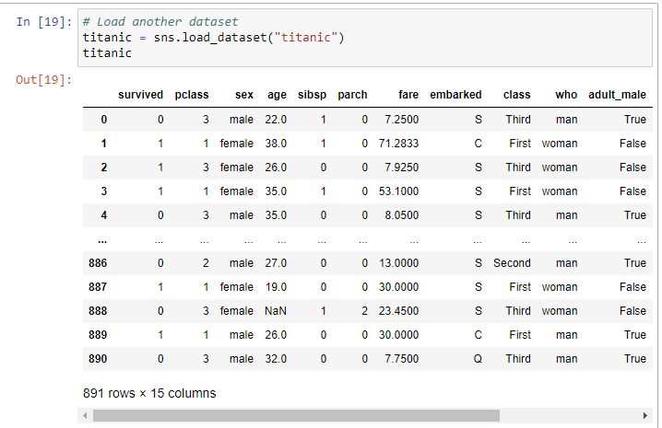

Slide 53
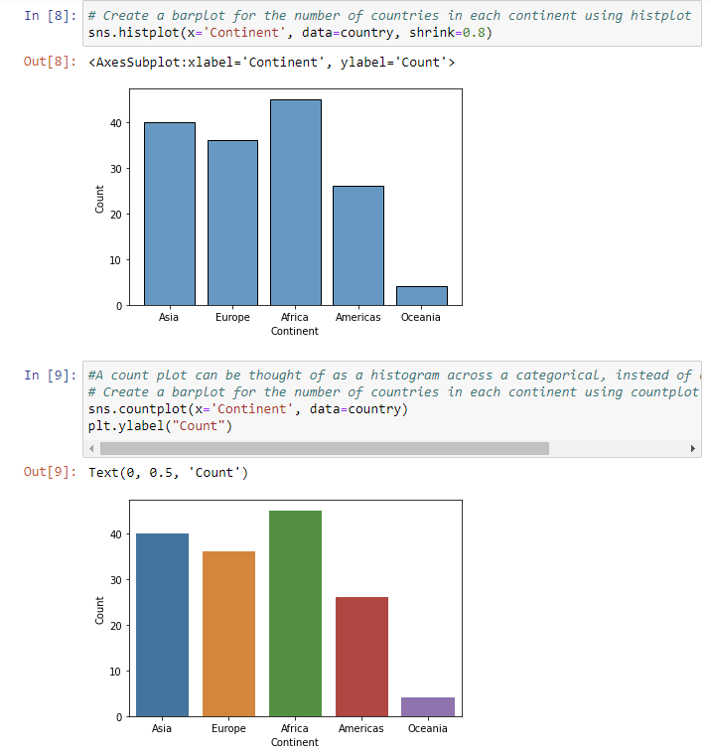

Slide 54
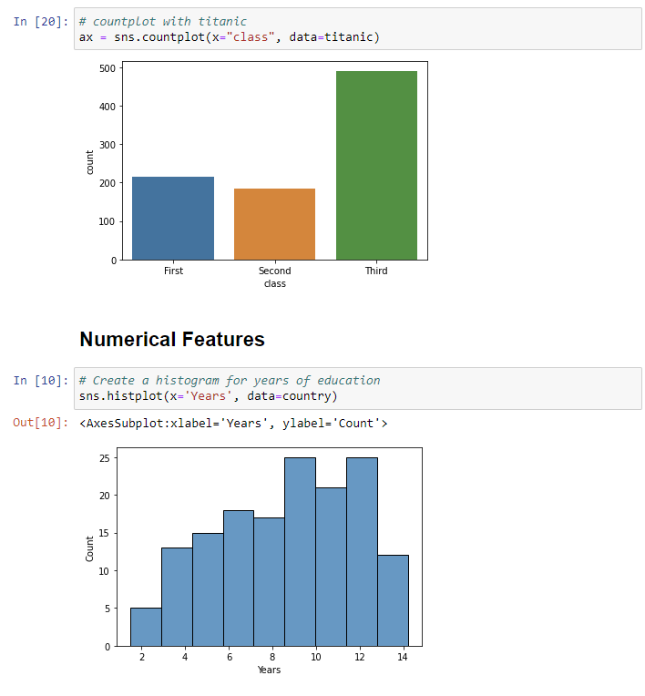

Slide 55
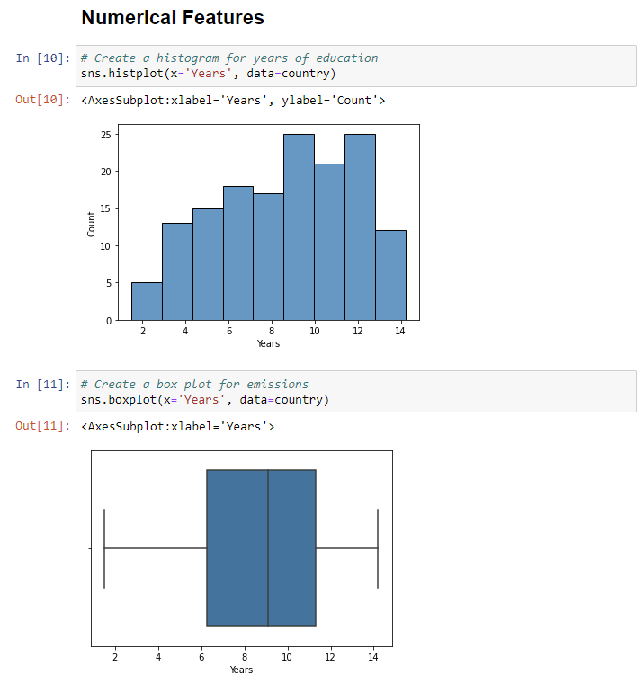

Slide 56
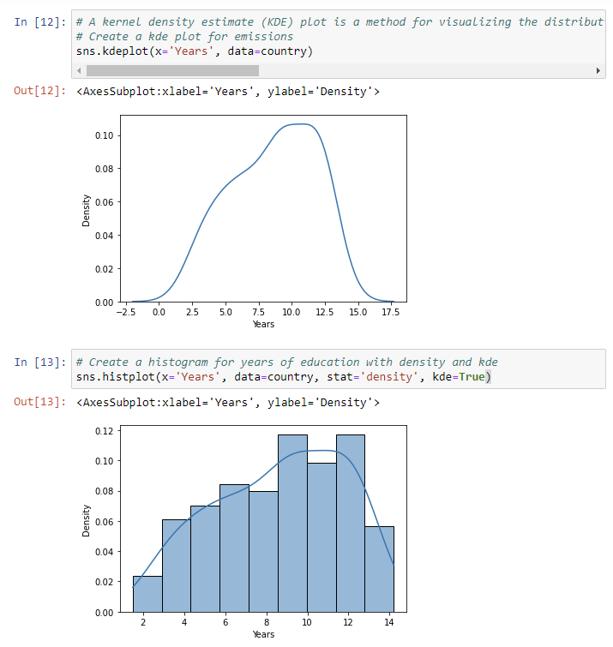

Slide 57
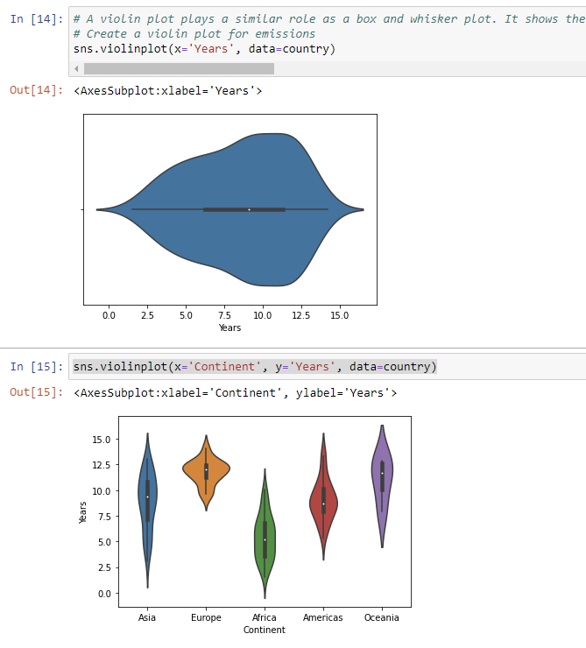

Slide 58
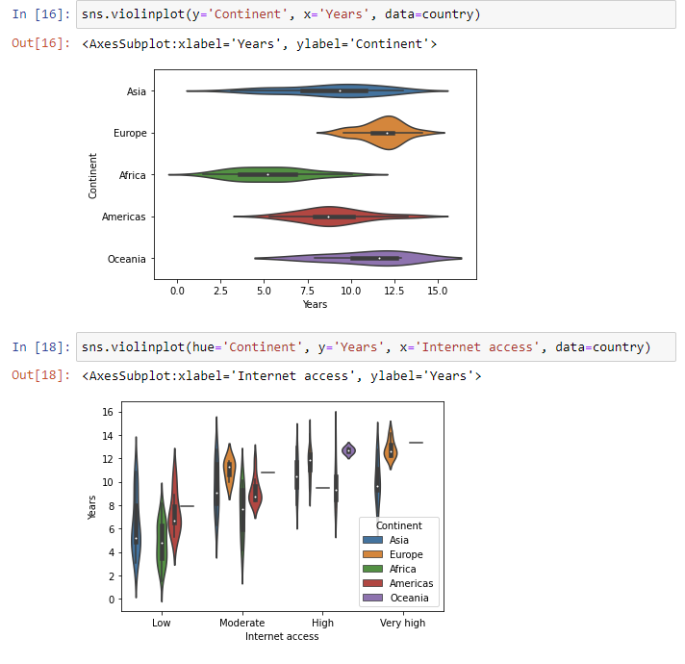

Slide 59
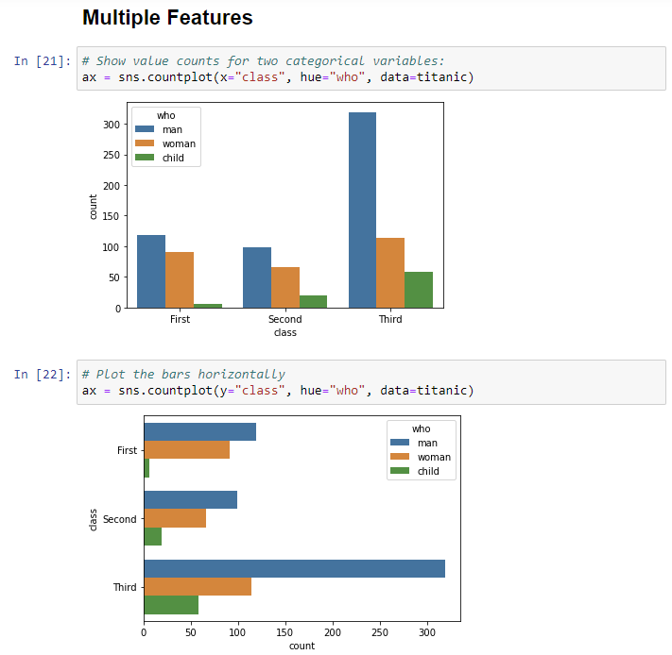

Slide 60
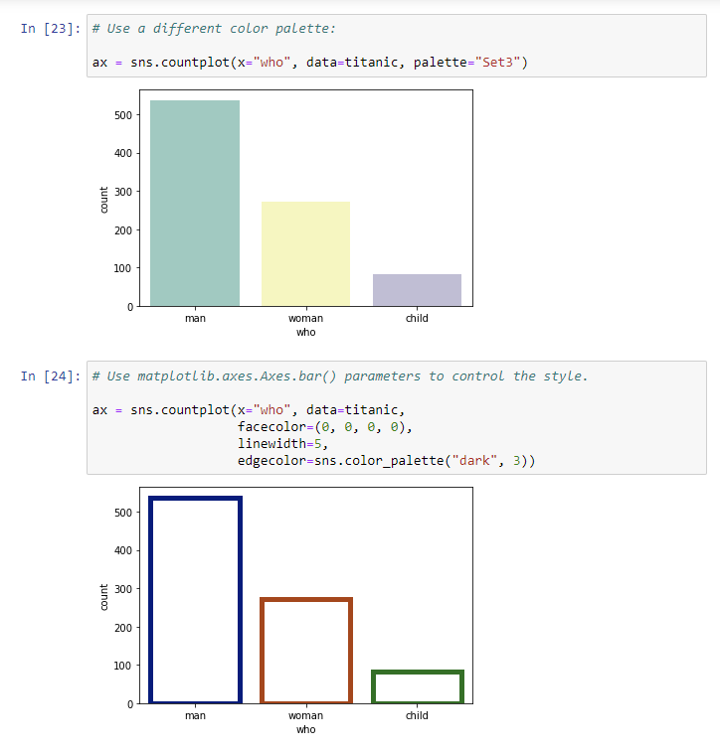

Slide 61
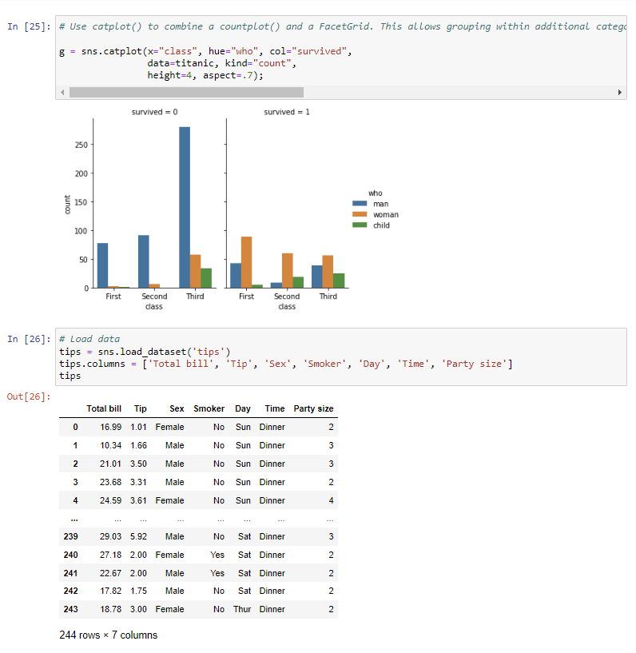

Slide 62
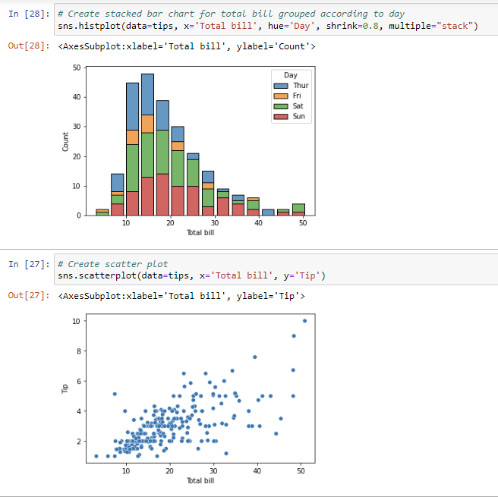

Slide 63
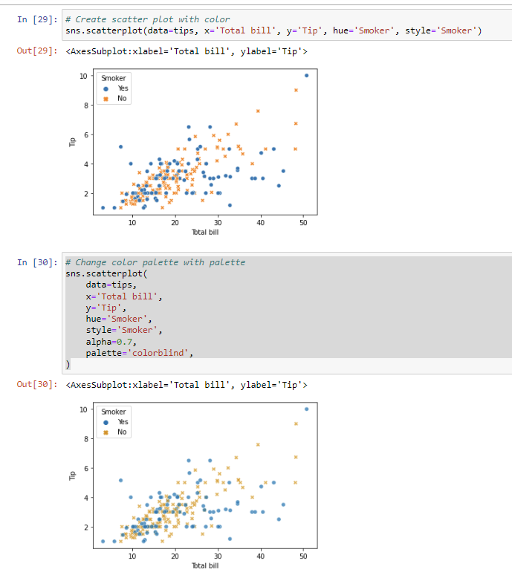

Slide 64
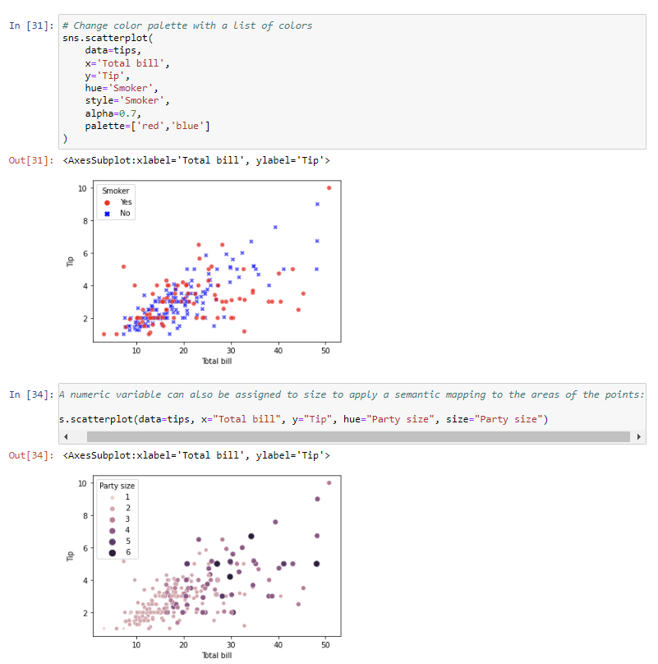

Slide 65
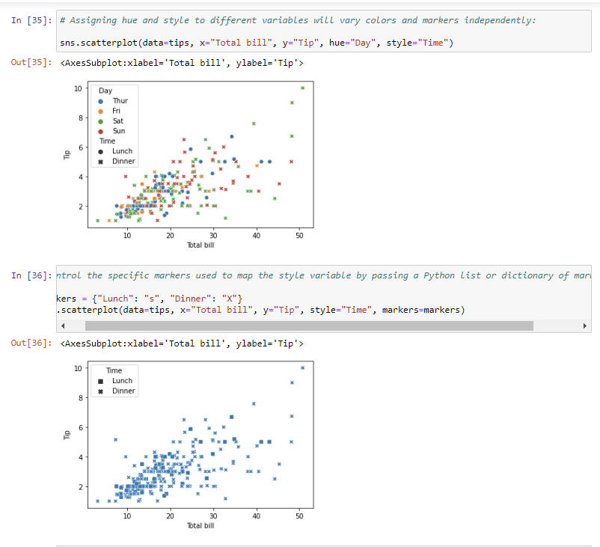

Slide 66
